Slide 1
Preparation of Final Accounts

Slide 2
INTRODUCTION
The stakeholders of a business are interested in financial progress. The assessment of financial progress is done by estimating the impact of business activities on financial position and financial status of the business. For this purpose, a business unit prepares final accounts. The final accounts which portray the financial position and financial status are ‘Income statement’ and ‘Balance Sheet’. Thus, the final accounts prepared to estimate business progress are as follows:

Slide 3
Objectives of Final Account preparation
Final accounts are prepared with the following objectives:
To determine profit or loss incurred by a company in a given financial period.
To determine the financial position of the company.
To act as a source of information to convey the users of accounting information (owners, creditors, investors and other stakeholders) about the solvency of the company.

Slide 4
Income statement or Profit and Loss Account
Profit and loss account reveals the results of the business firm’s activities for an accounting period. It includes the income and expenditure of a firm over a period of time and then by comparing such incomes and expenditures gives a final figure which represents the amount of profit and loss for the period. If income exceeds expenditure, the difference is called net profit and in case expenditure, exceeds income the difference is called net loss. The profit and loss account is also called as Income statement.

Slide 5
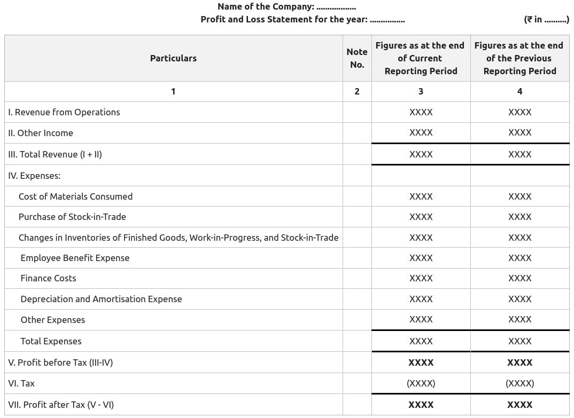

Slide 6
Balance Sheet
A balance sheet is a financial statement that reports a company's assets, liabilities and shareholders' equity at a specific point in time, and provides a basis for computing rates of return and evaluating its capital structure. Balance sheet maybe defined as a statement of assets and liabilities of the company at a particular date. Balance sheet is prepared and presented in the form prescribed in Schedule III, Part I of the Companies Act,2013. The form prescribed is vertical. Balance sheet must exhibit a true and fair view of the financial position at the close of the year.

Slide 7
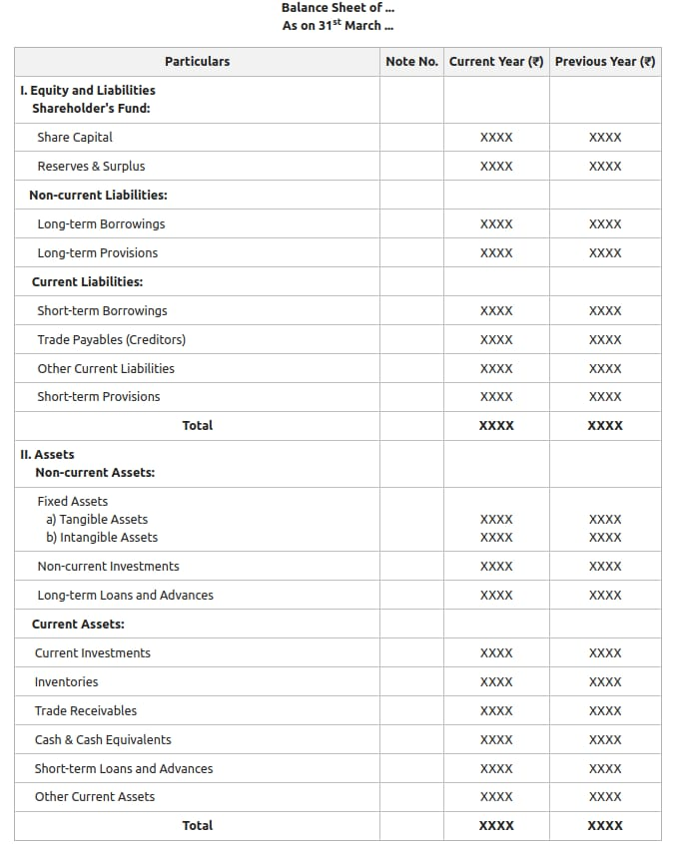

Slide 8
THANK YOU

